Slide 1
CREDIT RISK MODELING
SUBMITTED BY:
Ali Nafees
Ashwani Mittal
Abhishek Pokhrel

Slide 2
Executive Summary

Slide 3
Data
Month_Year | # Observations | Default Rate
201703 | 35,729.00 | 0.23
201704 | 36,294.00 | 0.24
201705 | 36,106.00 | 0.24
201706 | 37,094.00 | 0.24
201707 | 37,582.00 | 0.25
201708 | 38,083.00 | 0.25
201709 | 38,498.00 | 0.25
201710 | 38,910.00 | 0.25
201711 | 39,272.00 | 0.26
201712 | 39,713.00 | 0.26
201801 | 40,353.00 | 0.26
201802 | 40,923.00 | 0.26
201803 | 41,443.00 | 0.26
Total | 500,000.00 | 0.25
Explanation (Why this data and the target variable: Generate a Story for what Default means)
The Data comes from “American Express – Default Prediction” through Kaggle.
The purpose of analyzing this data is likely to understand the default rate trend over time and identify potential factors affecting the portfolio's performance. The dataset can be used to assess the credit risk of the portfolio and make informed decisions about risk management strategies.
The target variable in this dataset is the default rate, which represents the proportion of cases in the portfolio that have defaulted. A default happens when a borrower fails to repay the loan or credit on time, according to the terms and conditions of the agreement. In other words, the borrower has failed to meet their financial obligation and has become a risk to the lender or creditor.
Imagine that a person has applied for a loan to start a business. The lender has agreed to provide the loan, and the borrower has promised to repay the loan with interest within a specified period. However, after a few months, the borrower starts to experience financial difficulties and is unable to repay the loan on time. As a result, the borrower defaults on the loan, and the lender must take legal action to recover the unpaid debt. The default puts the borrower's credit rating at risk, making it harder for them to obtain credit in the future. It also causes financial losses for the lender, as they may have to write off the debt as a loss.

Slide 4
Features
Category | # of features
Delinquency | 96
Spend | 22
Payment | 3
Balance | 40
Risk | 28
Categories of Independent Variables
We used the above categories of independent variables shown on the table in the development process because
Delinquency: Represents the number of times a borrower has missed a payment or made a late payment. High delinquency rates indicate a higher likelihood of default and are therefore an important variable in credit risk models.
Spend: Represents the amount of credit a borrower utilized (Utilization). High levels of spend relative to credit limit can indicate higher risk as it may suggest that the borrower is overextended and may struggle to repay their debts.
Payment: Represents the amount of money paid towards outstanding debts. Low payment amounts relative to outstanding balances may indicate a borrower’s inability to repay their debts and a higher likelihood of default from them.
Balance: Represents the outstanding balance on a borrower’s credit account. High balances may indicate a higher level of debt and therefore a higher risk of default.
Risk: Represents the overall credit risk of a borrower, which may be determined by factors such as credit score, income, and even employment status. High-risk Borrowers are more likely to default on their debts and are therefore important variables in credit risk models.
Feature | Min | 1 Percentile | 5 Percentile | Median | 95 Percentile | 99 Percentile | Max | Mean | % Missing
B_1 | -0.8993963 | 0.0004953 | 0.0021349 | 0.0315985 | 0.6081213 | 1.0077209 | 1.3240526 | 0.1248744 | 0.0000000
B_4 | 0.0000002 | 0.0007239 | 0.0035917 | 0.0829695 | 0.6306981 | 1.0143551 | 4.2899550 | 0.1737489 | 0.0000000
D_45 | 0.0000019 | 0.0047124 | 0.0127235 | 0.1791543 | 0.7665610 | 1.0020126 | 1.5889961 | 0.2515066 | 0.0362000
B_3 | 0.0000001 | 0.0002578 | 0.0012116 | 0.0098044 | 0.7093485 | 1.0072909 | 1.6252622 | 0.1333195 | 0.0362000
P_2 | -0.3830190 | 0.0015249 | 0.2175581 | 0.6927839 | 0.9755750 | 1.0055927 | 1.0099995 | 0.6553730 | 0.8188000

Slide 5
Sampling
 | Sample | Time period | # Observations | Default rate
0 | Train | 2017-05 to 2018-01 | 345,608.00 | 0.25
1 | Test1 | 2017-03 to 2017-04 | 72,021.00 | 0.23
2 | Test2 | 2018-02 to 2018-03 | 82,366.00 | 0.26
Definition
Train: This is the Largest Portion of the dataset and is used to train the credit risk model. We train the model on this dataset to learn patterns and relationships between various features and the target variable, in this case, credit risk.
Test 1: This is a smaller portion of the dataset used to evaluate the model’s performance during the training phase. After training, the model is tested on this dataset to assess its ability to generalize and make accurate predictions on new unseen data. Hence, we can also call this validation set
Test 2: This completely independent dataset is used to evaluate the final performance of the model after it has been trained and tuned using the Train and Test 1 sets. Test 2’s purpose is to stimulate the performance of the model in the real world where it will encounter new, unseen data.

Slide 6
DATA PROCESSING/ ONE-HOT ENCODING
Categorical Variable Treatment
There were four categorical variables in the data set. However, we have not hot encoded two of them, that are customer_ID and date because they had no importance in the ML model. For the remaining two D_63 and D_64, We have hot encoded their value to 0 and 1. An abstract of the columns after hot encoded is below;
Code for One-Hot Encoding
one_hot = OneHotEncoder(handle_unknown = 'ignore')
one_hot.fit(merged_data[cat_list])
merged_data_encoded = pd.DataFrame(one_hot.transform(merged_data[cat_list]).toarray(),columns = one_hot.get_feature_names_out(cat_list))
merged_data = pd.concat([merged_data.reset_index(drop = True), merged_data_encoded.reset_index(drop=True)],axis = 1)
D_63_XZ | D_64_-1 | D_64_O | D_64_R | D_64_U | D_64_nan
0 | 0 | 1 | 0 | 0 | 0
0 | 0 | 1 | 0 | 0 | 0
0 | 0 | 1 | 0 | 0 | 0
0 | 0 | 1 | 0 | 0 | 0
0 | 0 | 1 | 0 | 0 | 0
0 | 0 | 1 | 0 | 0 | 0
0 | 0 | 1 | 0 | 0 | 0
0 | 0 | 1 | 0 | 0 | 0
0 | 0 | 1 | 0 | 0 | 0

Slide 7
Feature Selection
Category | # of features | # selected
Delinquency | 96 | 23
Spend | 22 | 5
Payment | 3 | 1
Balance | 40 | 12
Risk | 28 | 3
Feature Selection Technique
When we started building the model, we decided that any feature that had a feature importance below 0.5% would be overlooked and not accepted in our development process. We selected features with feature importance above 0.5%.

Slide 8
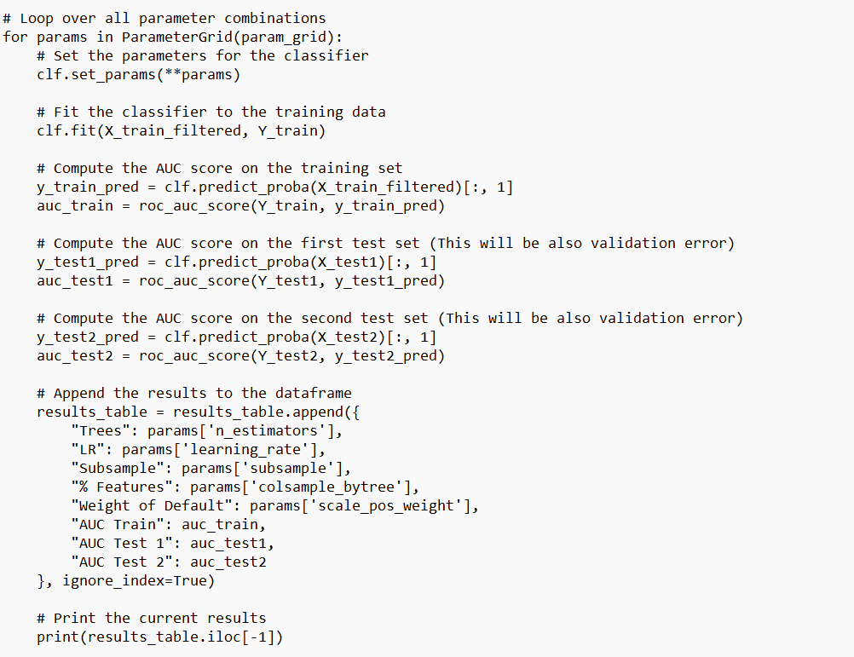
XGBoost- Grid Search
Grid Search Code for XGBoost
from sklearn.model_selection import ParameterGrid clf = xgb.XGBClassifier(objective='binary:logistic', seed=42)
# Define the parameter grid param_grid = {'n_estimators': [50, 100, 300], 'learning_rate': [0.01, 0.1], 'subsample': [0.5, 0.8], 'colsample_bytree': [0.5, 1.0], 'scale_pos_weight': [1, 5, 10]}
# Initialize the grid search grid_search = GridSearchCV(clf, param_grid=param_grid, cv=5, scoring='roc_auc', n_jobs=-1)
# Initialize the dataframe to store the results results_table = pd.DataFrame(columns=["Trees", "LR", "Subsample", "% Features", "Weight of Default", "AUC Train", "AUC Test 1", "AUC Test 2"])
Explanation for the Code
In this code I am using the XGBoost classifier and performing grid search using 5-fold cross-validation with 'roc_auc' as the scoring metric. The parameter grid consists of the following Hyperparameters;
n_estimators: number of boosting rounds or trees.
learning_rate: step size shrinkage used in the update to prevent overfitting.
subsample: subsample ratio of the training instances.
colsample_bytree: subsample ratio of columns when constructing each tree.
scale_pos_weight: control the balance of positive and negative weights.
In general, it’s a good idea to start with a small range of values and gradually increase or decrease the range based on the initial results.
Overall, we are training 72 models (3 * 2 *2 * 2 *3 =72) and storing the results in the dataframe. The results include the hyperparameters and the AUC scores for the training and two test sets.
We learned that computation time and resources needed increases with the increase in no of trees in training model. Therefore, if we had to run the model on 1.44M records we needed a computer with high power to process complex models.

Slide 9
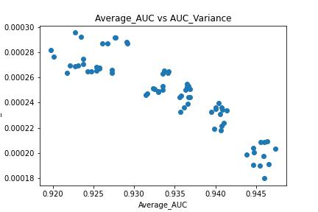
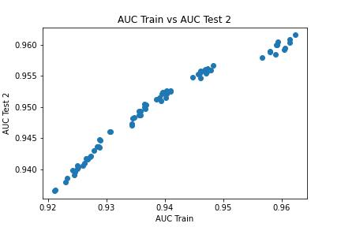
XGBoost – Grid Search
Scatter Plot 1
Scatter Plot 2
The model we chose had the following parameters; Tress 300, Learning Rate 0.1, Subsample 0.8, %Features 1, weight of Default 1. This gave us the results where the average AUC was highest being 0.95 with a variance of 0.002. This was the ideal model as average AUC peaks at the model with these parameters.

Slide 10
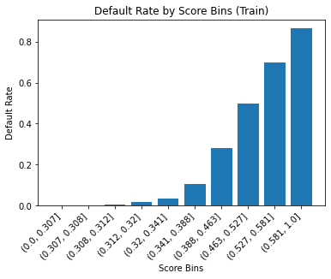
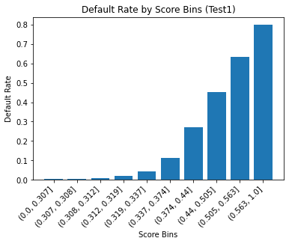
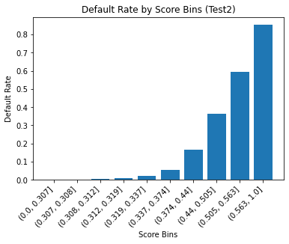
XGBoost – Final Model
Parameters for the best model are; {'Trees': 50.0, 'LR': 0.01, 'Subsample': 0.5, '%_Features': 0.5, 'Weight_of_Default': 1.0}

Slide 11
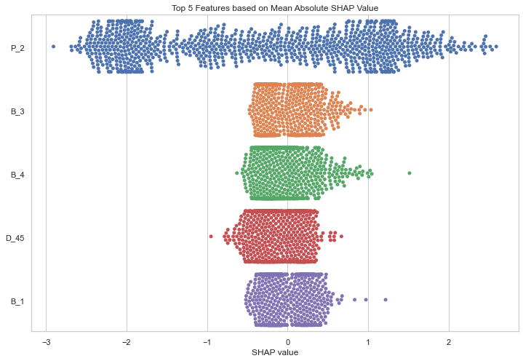
XGBoost – SHAP Analysis
Analyze the distribution of the SHAP values for each feature. If the SHAP values for a feature are mostly positive, it means that high values of that feature are associated with high values of the output.(For Example P2,B3,B1) Conversely, if the SHAP values are mostly negative, it means that low values of that feature are associated with high values of the output. (For example, P2,D45,B4)
B1, B3 and B4 show a positive correlation as seen in the graph their distributions is similar.. P2 has more feature importance and will impact the model the most.
B_4 and D_45 have a negative Correlation which in practical will not make sense because higher the credit balance higher the risk of delinquency is there.

Slide 12
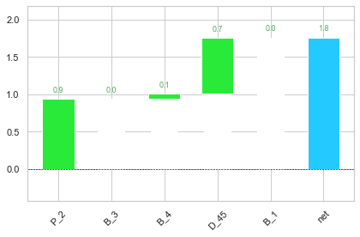
XGBoost – SHAP Analysis

Slide 13
Neural Network – Data Processing
Neural networks are a type of machine learning model used for predictive modeling. This code processes the data for a neural network by first performing missing value imputation, filling all missing values with 0. The data is then split into three sets: train, test1, and test2. The train_data_NN set contains data from May 1, 2017, to January 31, 2018. The test1_data_NN set contains data from March 1, 2017, to April 30, 2017. The test2_data_NN set contains data from February 1, 2018, to March 31, 2018.
Code for Missing Value Imputation merged_data.fillna(0,inplace=True)
Code for Splitting Data train_data_NN = merged_data[(merged_data['S_2']>='2017-05-01') & (merged_data["S_2"] <= '2018-01-31’)] test1_data_NN = merged_data[(merged_data['S_2']>='2017-03-01') & (merged_data['S_2'] <= '2017-04-30’)] test2_data_NN = merged_data[(merged_data['S_2']>='2018-02-01') & (merged_data['S_2'] <= '2018-03-31’)]
The target_col variable is the name of the column containing the target variable to be predicted, and drop_cols is a list of columns to be dropped from the dataset before training the model. The important_features variable contains a list of important features that will be used for training the neural network.
Next, the data is normalized using a StandardScaler object from the scikit-learn library. This object scales the data to have zero mean and unit variance. The normalized data is then converted back to a pandas DataFrame.
Outliers are then treated for each of the three datasets by replacing any values outside of the 1st and 99th percentiles with the corresponding minimum or maximum value. This is done using a for loop that iterates through each column of the dataset and applies the outlier treatment function.

Slide 14
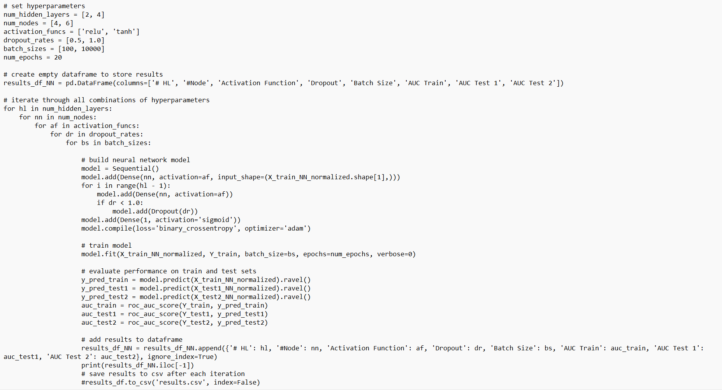
Neural Network – Grid Search
Finally, after we have processed the data now, we are ready to run the grid search. We are using the Keras to build the neural network model. We have defined a range of hyperparameters to search over, including the number of hidden layers, number of nodes per layer, activation function, dropout rate, batch size, and number of epochs. For each combination of hyperparameters, we build a model and evaluate it on the training set, test 1, and test 2. We are storing the results in the dataset.
Overall, we have run 32 Models. One suggestion would be to use cross-validation instead of a single train/test split, to get a more reliable estimate of model performance. Additionally, you could try using more advanced techniques for handling missing values, such as imputing with mean/median or using a more sophisticated imputation model.

Slide 15
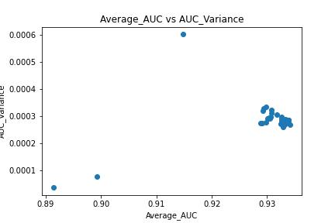
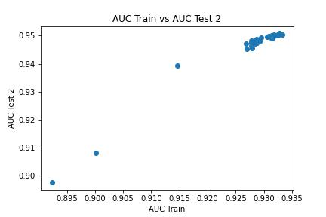
Neural Network – Grid Search
Scatter Plot 1
Scatter Plot 2
Explanation for which model to choose based on scatter plots above

Slide 16
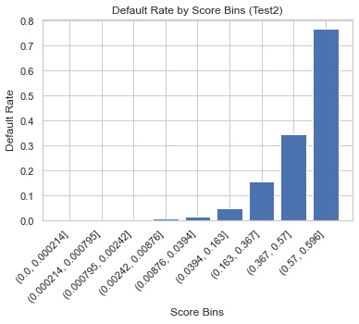
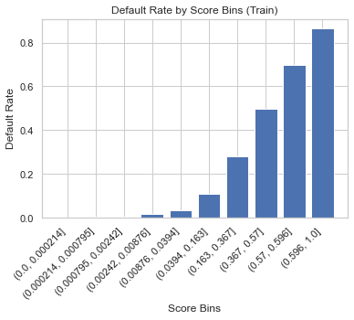
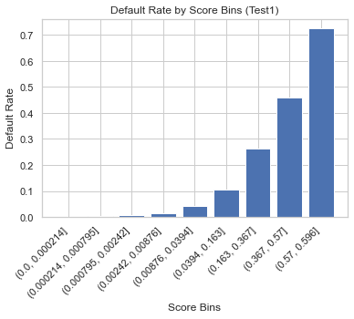
Neural Network – Grid Search

Slide 17
Final Model
Model Name | AUC_Train | AUC_Test1 | AUC_Test2 | Train_Error | Val_Error1 | Val_Error2 | Average_AUC | Variance_AUC
Neural Network | 0.931449971 | 0.916304853 | 0.950177356 | 0.068550029 | 0.083695147 | 0.049822644 | 0.933241104 | 0.000286837
XGBoost | 0.928879763 | 0.910651887 | 0.94481741 | 0.071120237 | 0.089348113 | 0.05518259 | 0.927734649 | 0.000291821

Slide 18
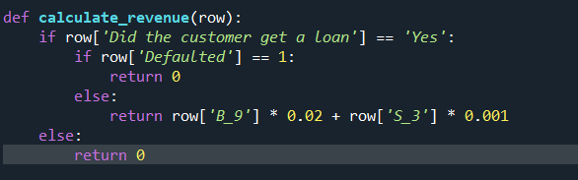
Strategy

